Slide 1


STUDENT NAME : Dhanush I
REGISTER NO/NMID: 2422j1104/asbru062422j1102
DEPARTMENT: Bacholar Of Computer Applications COLLEGE/UNIVERSITY:CGAC Tiruppur /Bharathiyar University

Slide 2

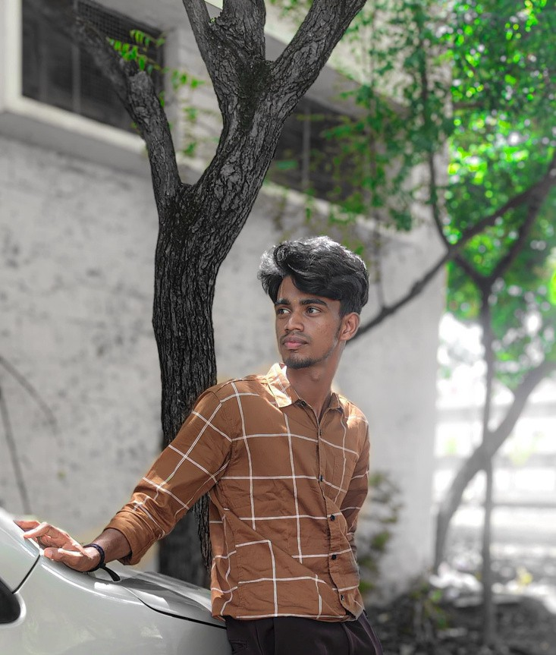

TITLE
DIGITAL PORTFOLIO
A JOURNEY THROUGH MY SOFTWARE PORTFOLIO
Welcome to my world of code and creativity, where ideas transform into impactful solutions

Slide 3


CONTENTS
Problem Statement
Project Overview
End Users
Tools and Technologies
Portfolio design and Layout
Features and Functionality
Results and Screenshots
Conclusion
Github Link

Slide 4


PROBLEM STATEMENT
There was a need for a personal portfolio website that showcases my education, technical skills, achievements, and contact information in a professional way.
The challenge was to design it responsive, modern, and interactive while being easy to maintain.

Slide 5




PROJECT OVERVIEW
This project is a responsive portfolio website developed using HTML, CSS, and JavaScript.
It includes multiple sections: Home, Education, Skills, About Me, and Contact.
.
.
The design is enhanced with animations, dark/light themes, and interactive effects.

Slide 6


END USERS
Recruiters To evaluate my skills & projects
Academic faculty For showcasing achievements
Peers/Colleagues For collaboration and inspiration
Myself As a professional online presence

Slide 7

TOOLS AND TECHNOLOGY'S
HTML5 Structure
CSS3 Styling and Layout
JavaScript Interactivity
Font Awesome - Icons
Google Fonts Typography
Responsive Design Principles

Slide 8
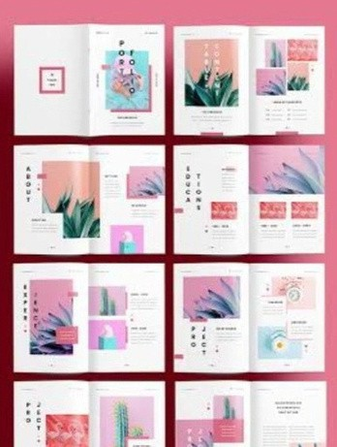

PORTFOLIO DESING AND LOYOUT
Home Introduction with image & title
Education Timeline format
Skills Skill cards with hover animations
About Me Career objective, achievements, hobbies
Contact Form & contact details
Footer Social media links

Slide 9
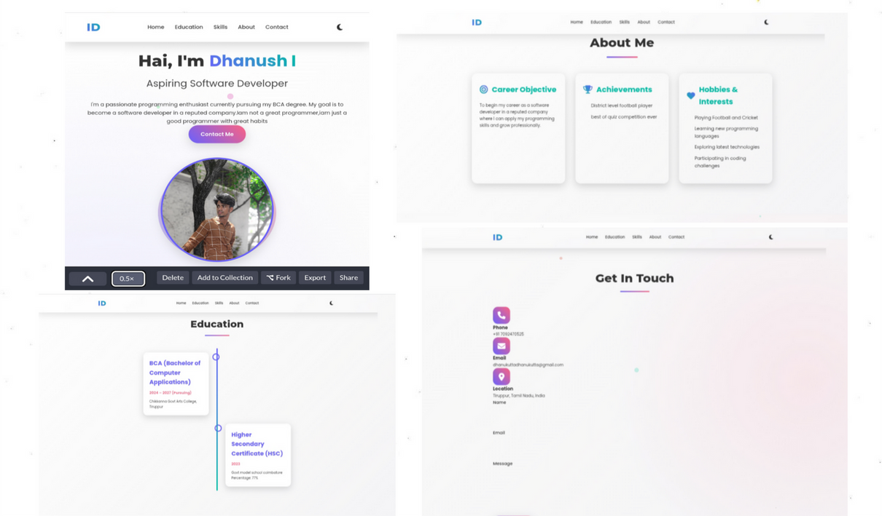
RESULT AND SCREENCHATS
Screenchats of
Home Page
Education Timeline
Skills Section Contact Form
08

Slide 10


CONCLUSION
Through this project. I have:
Improved my front-end development skills Learned responsive and interactive web design
Built a professional portfolio for future career opportunities
08

Slide 11

GITHUB LINK
GitHub Repository: (https://github.com/dhanukuttadhanukutta-
arch/I.Dhanush-TNSDC-FWD-DP.git)
Phone: +91 7092470525
Email: dhanukuttadhanukutta@gmail.com
08

Slide 12
THANK YOU

